Slide 1
Manufacturing Industry beyond the Historic Core
Why?
Where?

Slide 2
A. Why?
Import substitution versus export orientation (former historically most important)
-- size of country (economies of scale)
-- began in 1920s (imitation of US and Japan)
-- after 1970s export orientation made more sense (small countries, export processing zones) because of strategic partnerships with multinational businesses and attraction of FDI

Slide 3
Practical Logic of Export Orientation as Stimulus to Economic Growth
1. Manufacturing and “stage” of economic growth (Figure 1)
2. Phases of production and factors of production (product life-cycle as a metaphor) (Figures 2-4)
3. Decline in transport costs and rise of global supply chains (Figures 5&6)
4. From Export Processing Zones (EPZs) to industrial districts (Figure 7)

Slide 4
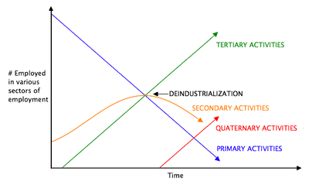
Figure 1:Clark’s model of trends in employment with increased economic development

Slide 5
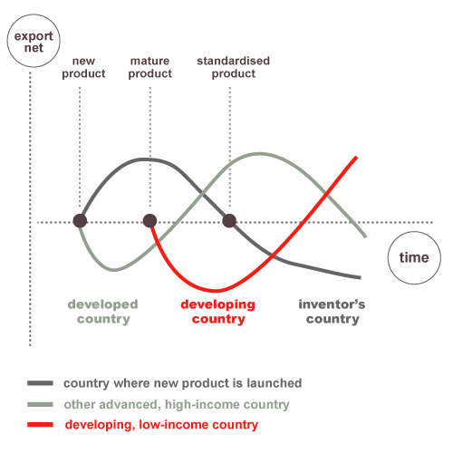
Figure 2: Product Life-Cycle Model

Slide 6
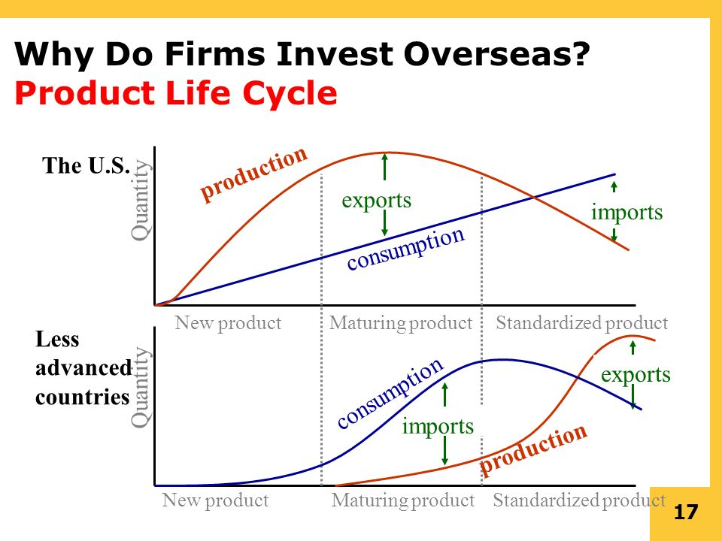
Figure 3

Slide 7
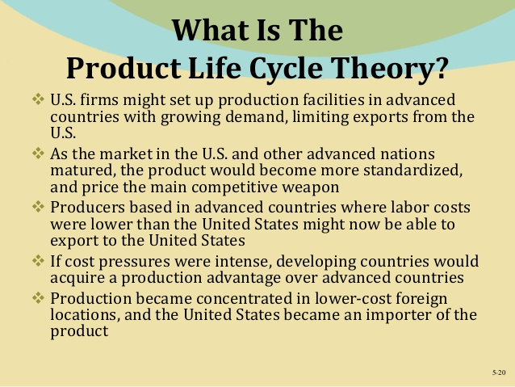
Figure 4

Slide 8
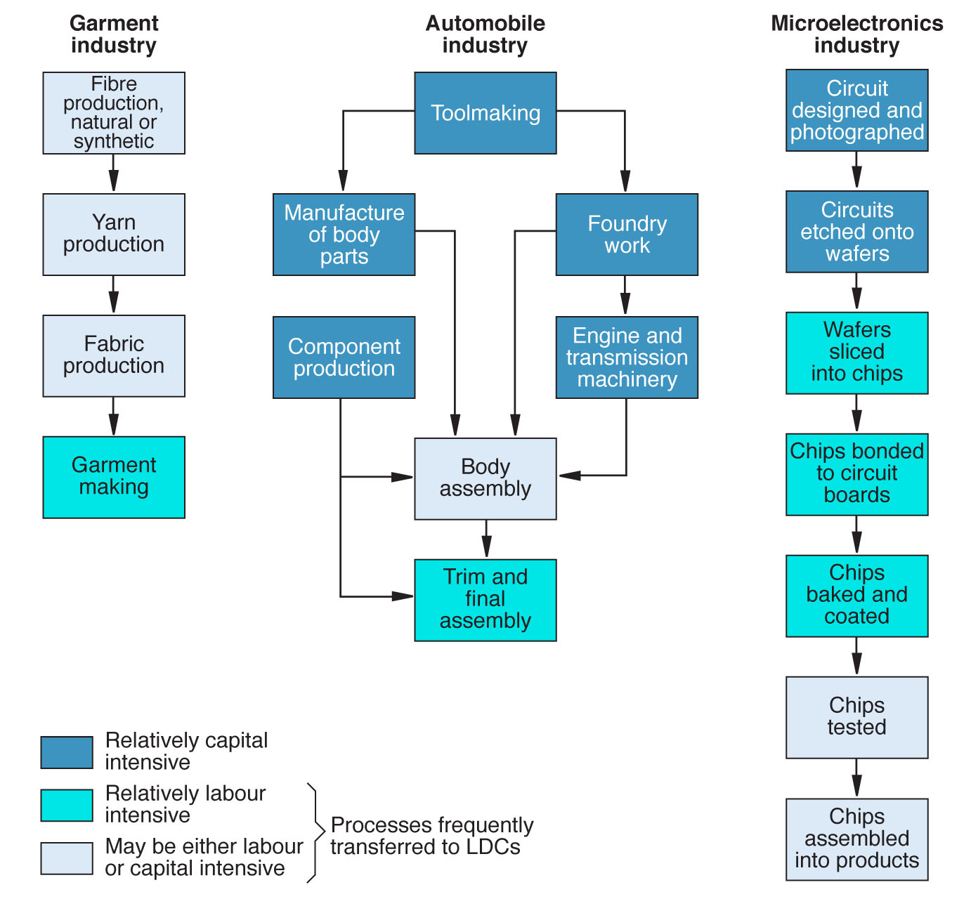
Figure 5: Capital and labor-intensive phases of production

Slide 9
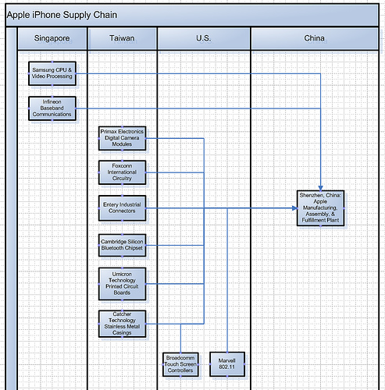
Figure 6: The Apple iPhone Supply Chain

Slide 10
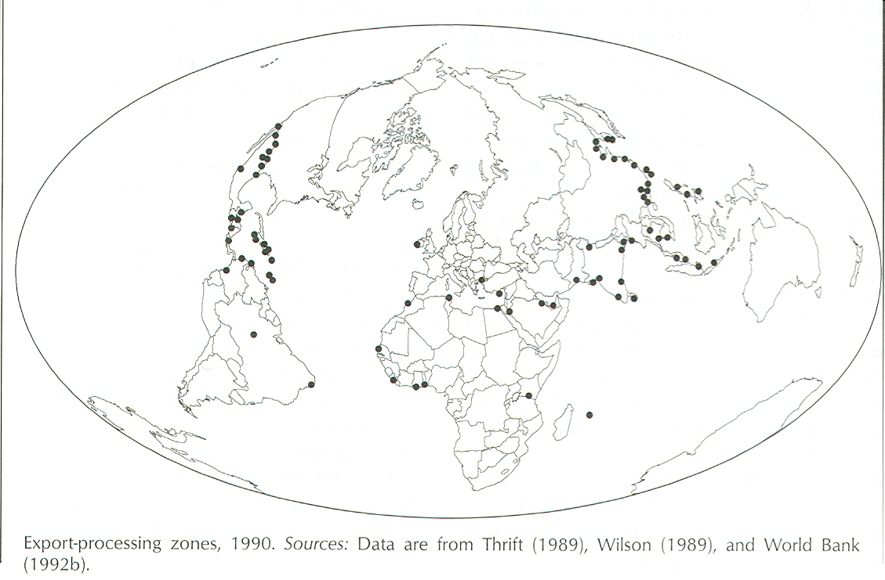
Figure 7: Export-Processing Zones

Slide 11
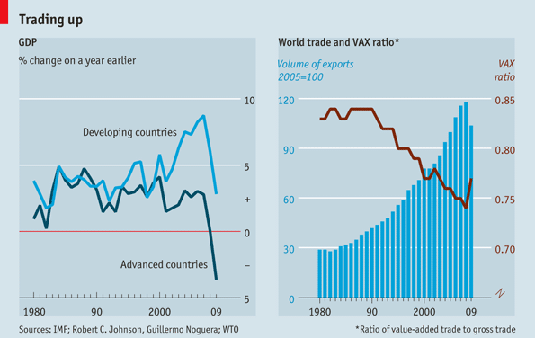
Figure 8: Parts and Components in World Trade

Slide 12
Vulnerabilities?
Fuel costs/sustainability of long-distance supply chains (Figure 9)
Just-in-time manufacturing and flexibility in supply of parts/components (adjacency as advantage e.g., Mexico and US) (Figures 10-14)
Are factor advantages (such as lower labor costs) forever? – ageing of labor forces (Figures 15-16)
Geopolitics of global economic competition and rise of protectionism in historic core (e.g., “China bashing” in US presidential elections) (Figure 17)

Slide 13
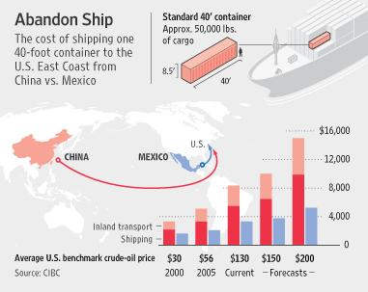
Figure 9

Slide 14
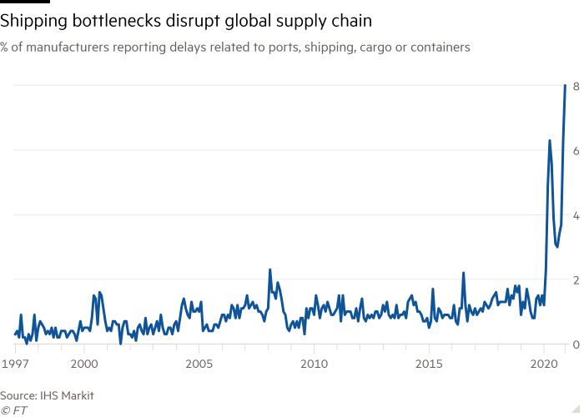
Figure 10: Bottlenecks are Costly with Just-in-Time Delivery

Slide 15
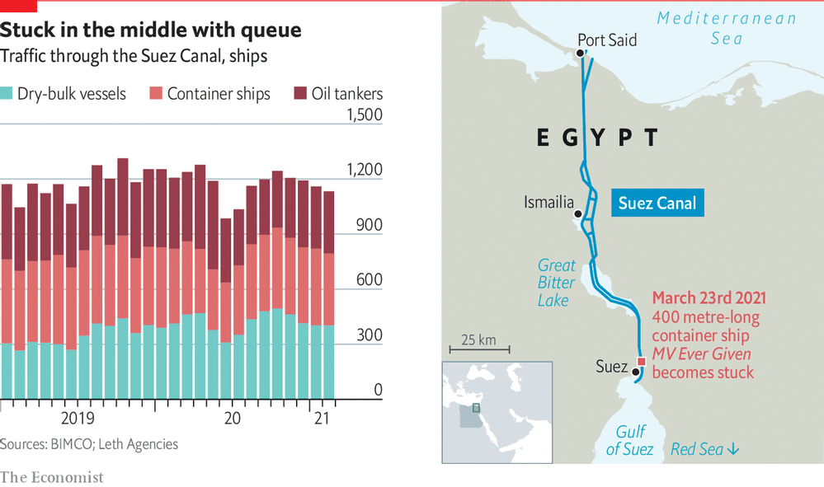
Figure 11: Supply Chain Choke Points

Slide 16
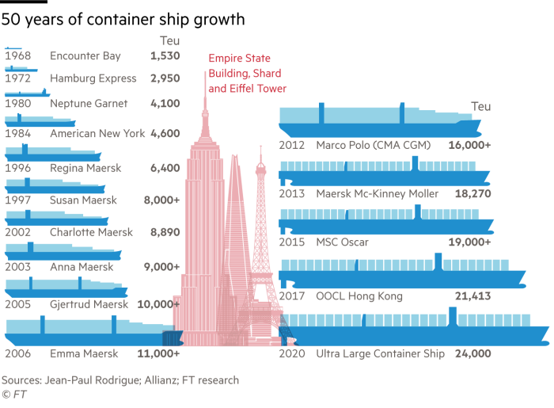
Figure 12: As Container Ships Get Bigger …

Slide 17
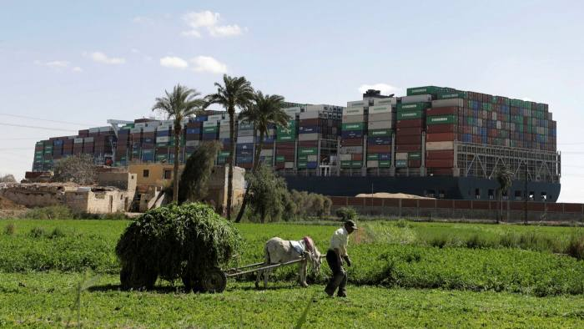
Figure 13: Blocking the Suez Canal, early 2021

Slide 18
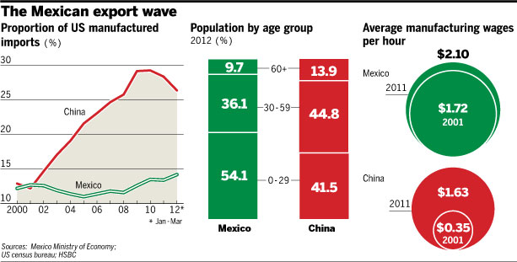
Figure 14

Slide 19
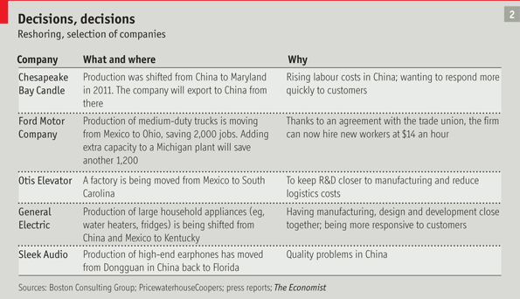
Figure 15: Reshoring?

Slide 20
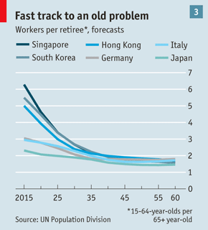
Figure 16: Ageing Labor Forces Everywhere (except Africa)

Slide 21
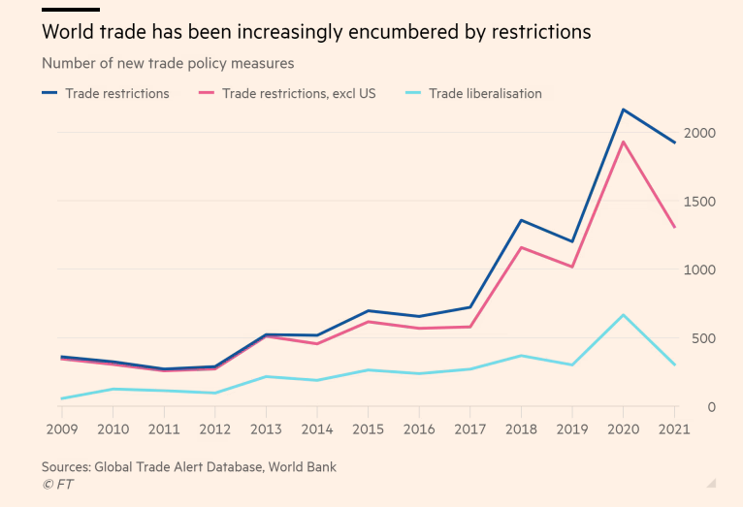
Figure 17: Rising Protectionism

Slide 22
B. Where?
1. Growth of global manufacturing output in period 1995-2005 (Figure 18)
2. Three “tests” of industrialization: i. at least 25% of GDP in industry (includes resource sector); ii. at least 60% of industrial output in manufacturing; iii. at least 10% of total population employed in industry. Two “pathways” to successful industrialization: E – C – A (a mining enclave or resource base provides beginning) and D – B – A (starts with manufacturing and expansion of this sector fuels growth of industrial employment) (Figure 19)

Slide 23
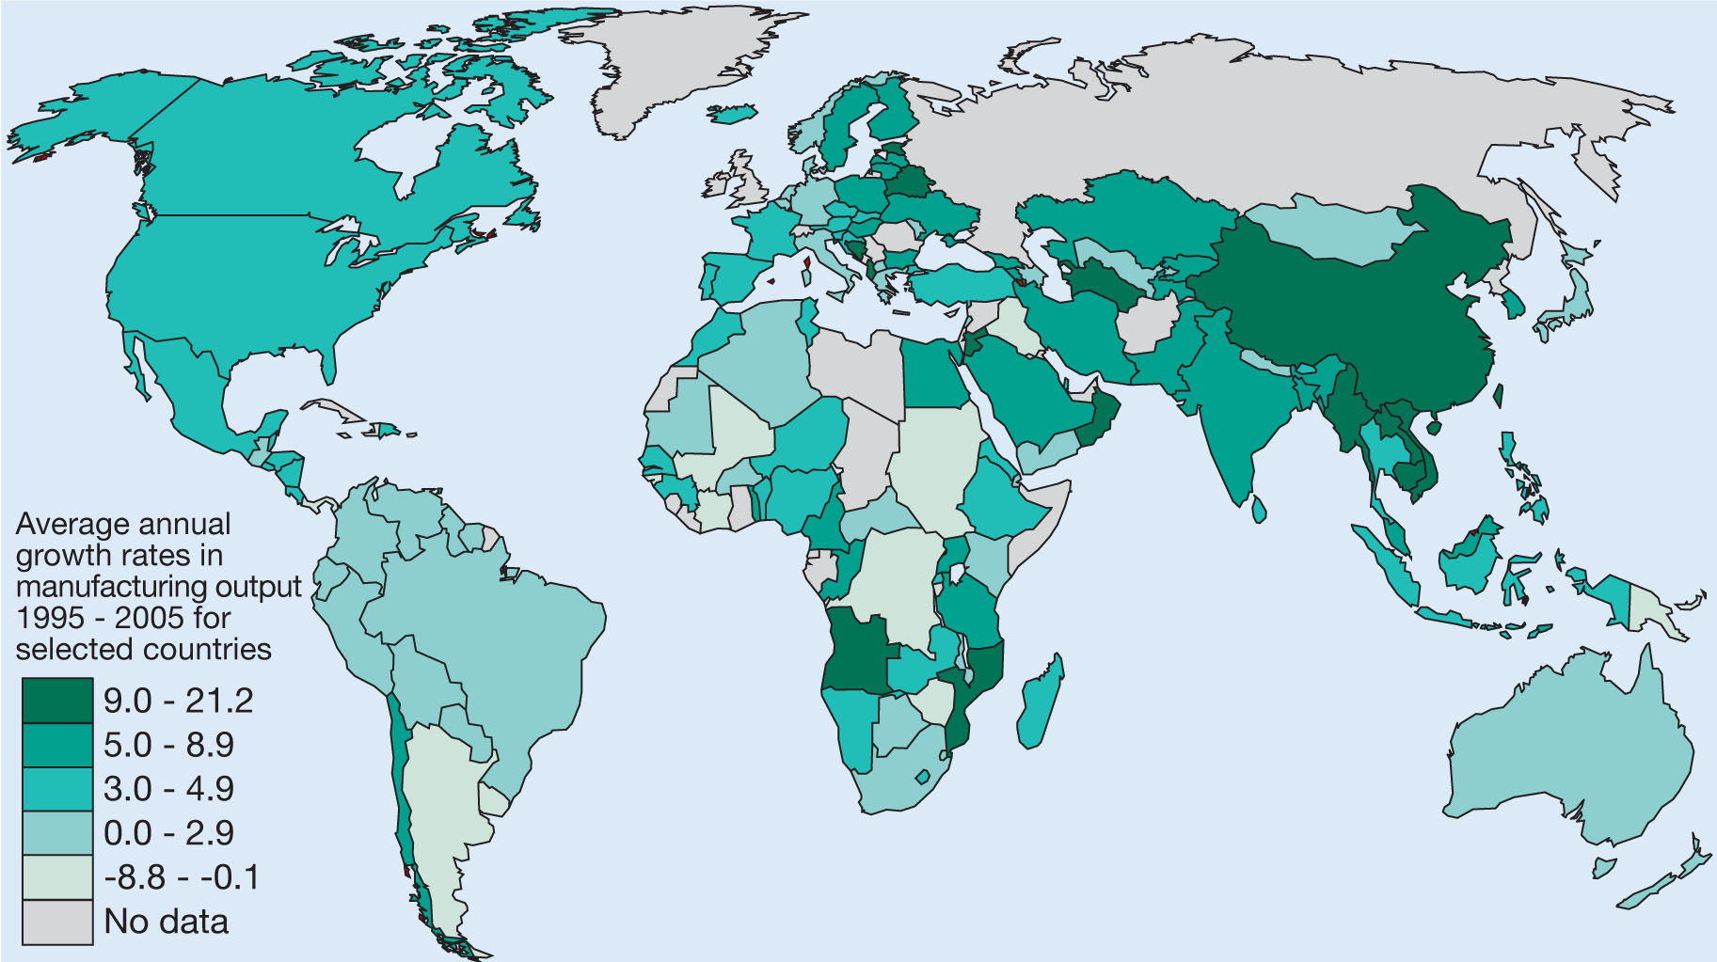
Figure 18: Rates of growth in manufacturing output, 1995-2005

Slide 24
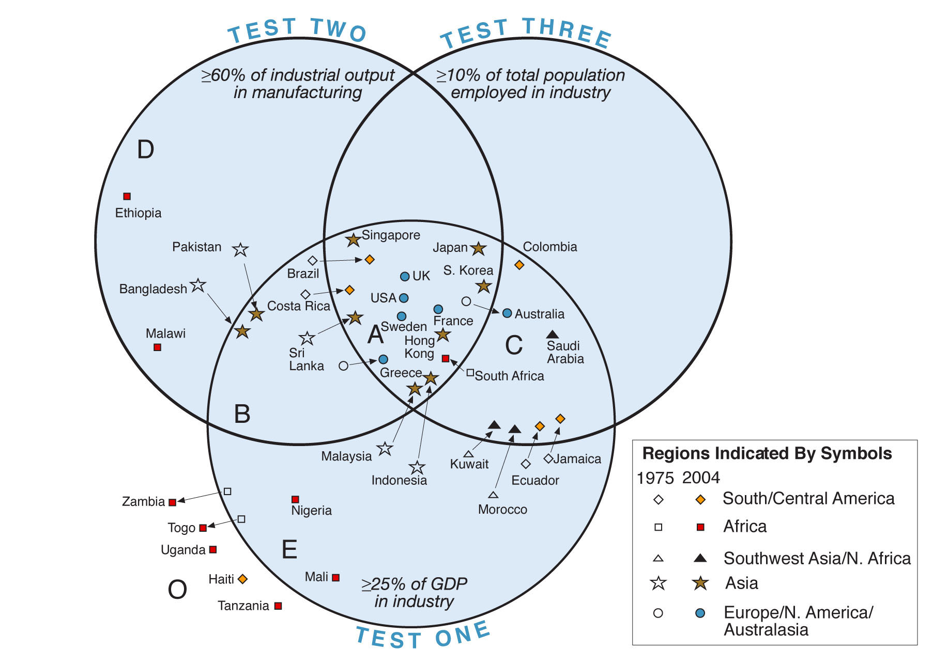
Figure 19: Three “tests” of industrialization

Slide 25
First pathway is rare. Second is common only in SE and East Asia and in Mexico and Brazil.
So-called Newly Industrializing Countries (see map) (Figure 20)
Where is it NOT happening (Middle East and Africa – except South Africa)?
The BRICs (abandoned import substitution for export orientation) (Figures 21-22)

Slide 26
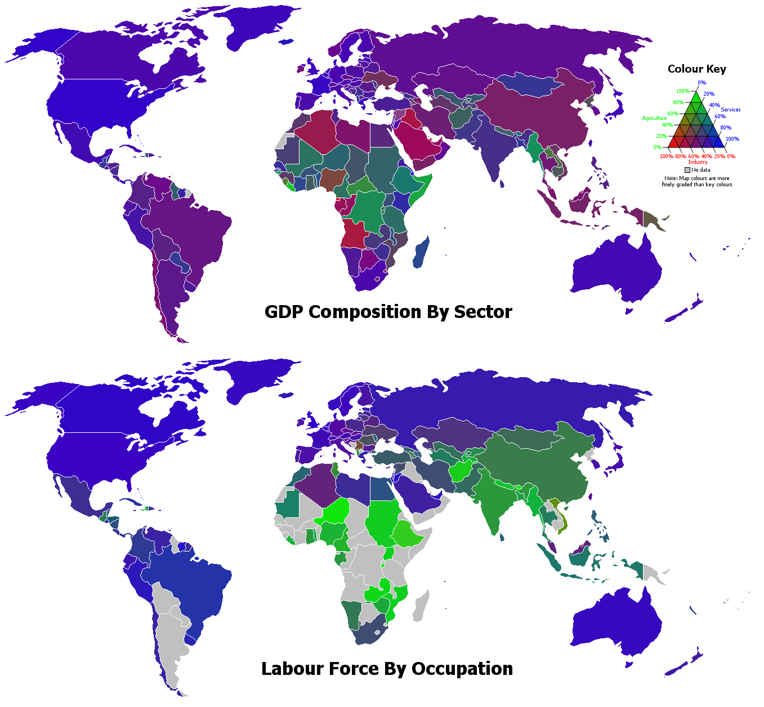
Figure 20

Slide 27
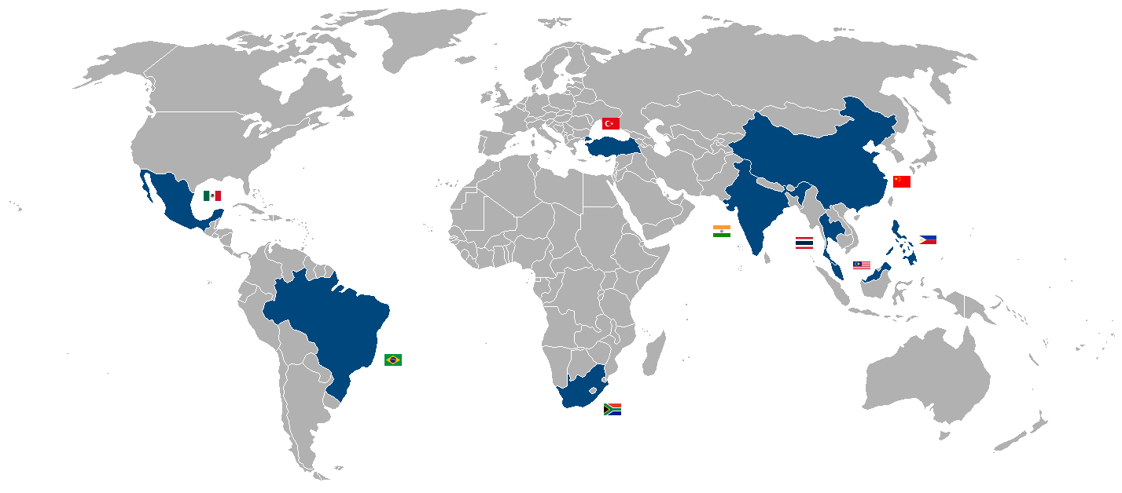
Figure 21: Of NICs and BRICs

Slide 28
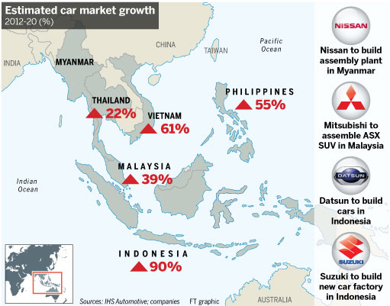
Figure 22: A S.E. ASIAN EXAMPLE

Slide 29
China as overwhelmingly most important NIC and BRIC!! (Figures 23 and 24) But period of high growth has probably passed (Figure 25).
“Sino-dependency” of neighbors and world economy since 2005 (major creditor to US, “global growth engine,”) (Figure 26)

Slide 30
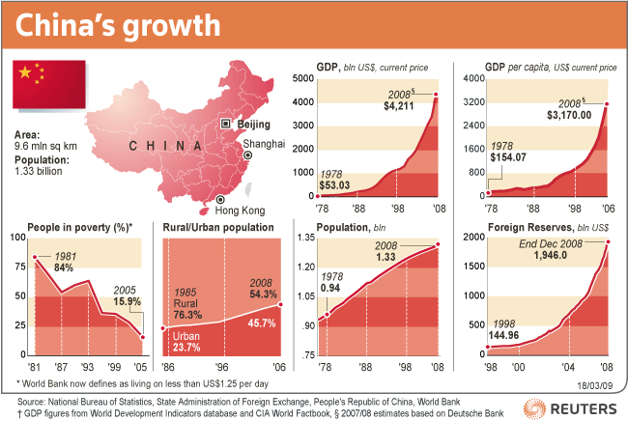
Figure 23

Slide 31
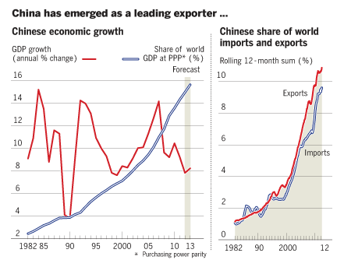
Figure 24

Slide 32
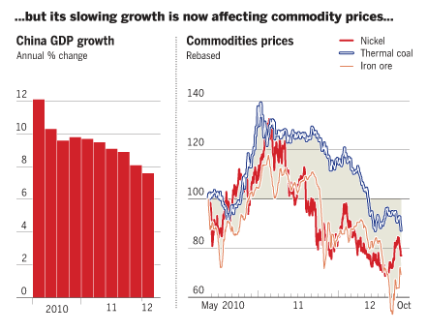
Figure 25

Slide 33
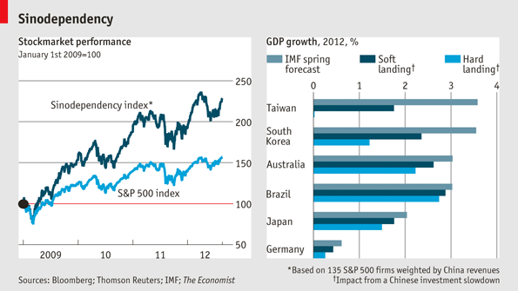
Figure 26

Slide 34
Cities as major centers of new industrial growth but can have city population growth without economic growth (compare Asia and Africa) and incomes then do not increase (Figure 27a and b)
Cities beyond historic core rising in global economic importance (Figure 28)
Semi-periphery increasingly responsible for worldwide economic growth (Figures 29&30).
Middle-Income Trap (Figure 31)

Slide 35
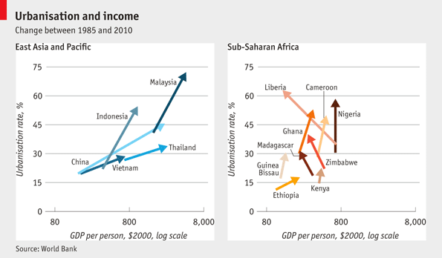
Figure 27a

Slide 36
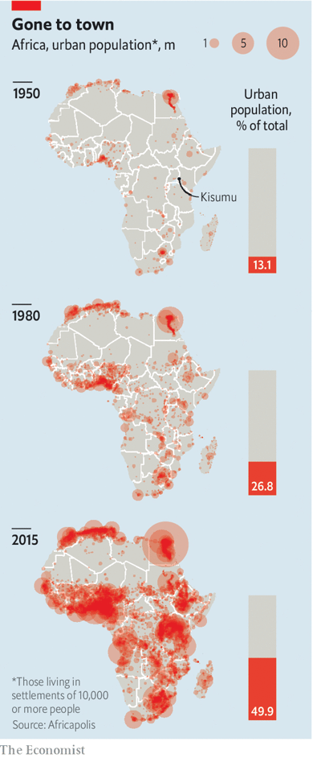
Figure 27b: Urbanization without jobs?

Slide 37
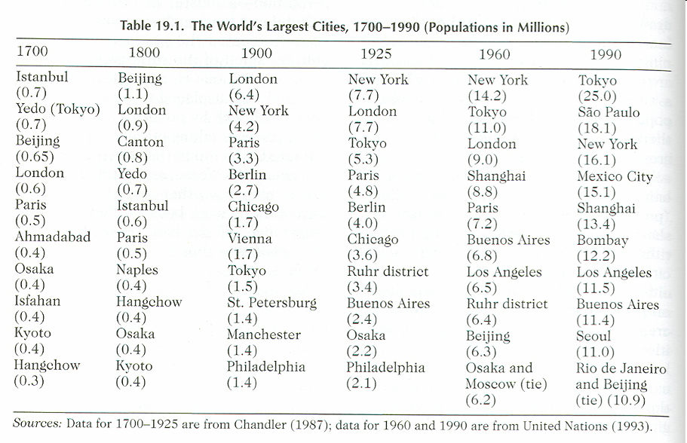
Figure 28

Slide 38
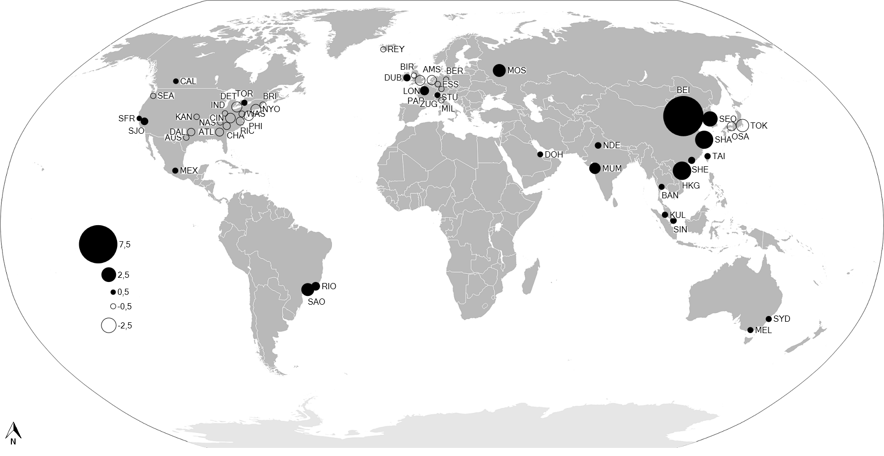
Figure 29: Growth and Shrinkage in Financial Services (2007-2012)

Slide 39
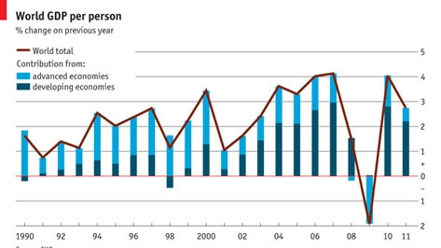
Figure 30

Slide 40
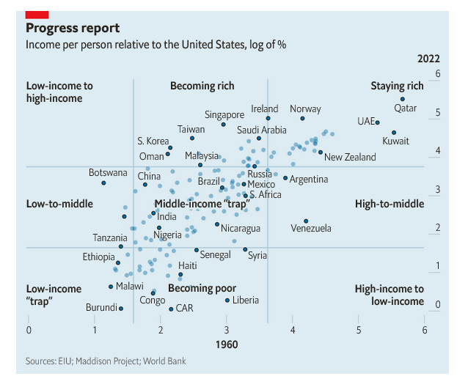
Figure 31: Middle-Income Trap

Slide 41
Conclusions
1. Match countries’ factor endowments and multinationals’ global supply chains
2. “Opening up” of world economy since 1970s (tariff reductions, end of Bretton Woods)
3. Competitive advantage built by some countries on the base of import substitution and/or investments in infrastructure and human capital
4. Emerging firm-off-shoring economies of scale and agglomeration economies in some cities outside the historic core

